Slide 1
COURSERA FINAL CAPSTONE PROJECT
COURSERA IBM DATASCIENCE CERTIFICATION
NAEEM SHAIKH APRIL 2020

Slide 2

REPORTCONTENT AND PRESENTATION OUTLINE
1.Introduction
The “Business problem” to be solved by this project and interested audience 2.Data section Data requirements and data sources needed to investigate the problem
2. Methodology
Main technical component of the report- execution of data processing techniques, exploratory data analysis and machine learning techniques used
3. Results
Discussion of results
Discussion Observations leading to conclusion
Conclusion -Final decision

Slide 3

1. INTRODUCTION
1.1 Scenario and Background
I currently live in Riverside Quay, Southbank, Melbourne, Australia within walking distance to the central business district, train stations and food amenities, shopping malls and festivals. I have an offer to move to Manhattan New York and would like to do a cost benefit analysis to see if I can
afford to maintain the same lifestyle/location with the offered salary. Problemstatementto resolve
Tofind an apartment with minimumof 2 bedrooms,price of MaximumUS$7000 per monthlocated within 1.5 kilometers of subway along with great food amenities
Interested Audience
I believe this project is interesting for any expat deciding to migrate to the united states and would liketoleveragetoolssuchasfoursquareanddatasciencetomakeaninformeddata driven decision. The project is replicable for other cities and having a background in data science is recommended.

Slide 4
2.DATA SECTION
2.1 Data Requirements
Geodata for current residence in Southbank with venues established using Foursquare List of Manhattan (MH)neighbor-hoods with clustered venues established via Foursquare (as in Course
Lab). https://en.wikipedia.org/wiki/List_of_Manhattan_neighborhoods#Midtown_neighborhoods List of subway metro stations in Manhattan with addresses and geo data (lat, long): https://
en.wikipedia.org/wiki/List_of_New_York_City_Subway_stations_in_Manhattan) , (https://www.google.com/ maps/search/manhattan+subway+metro+stations/@40.7837297,-74.1033043,11z/data=!3m1!4b1)
List of apartments for rent in Manhattan area with information on neighborhood location, address, number of beds, area size, monthly rent price and complemented with geo data via Nominatim. http://
www.rentmanhattan.com/index.cfm?page=search&state=results https://www.nestpick.com/search? city=new-
Place to work in Manhattan (Park Avenueand 53rd St) for reference
2.2 Data Sources, Data Processing and Tools used
Southbank data and map is to be created with use of Nominatim , Foursquare and Folium mapping Manhattan neighborhoods were obtained from Wikipedia and organized by Neighborhoods with
geodata via Nominatim for mapping with Folium. List of Subway stations was obtained via Wikipedia, NY Transit web site and Google map,
List of apartments for rent was consolidated from web-scraping real estate sites for MH. The geolocation (lat, long) data was found with algorithm coding and using Nominatim.
Folium map was the basis of mapping with various features to consolidate all data in ONE map where one can visualize all details needed to make a selection of apartment

Slide 5
3. METHODOLOGY
The Strategy to find the answer: The strategy is based on mapping the described data in section 2.0, in order to
facilitate the choice of at least two candidate places for rent. Theinformation will be consolidated in ONEMAPwhere one canseethe details of the apartment, the cluster of venuesin the neighborhood and the relative location from a subway station and from workplace. A measurementtool icon will also be provided. The popups onthe map items will display rent price, location and cluster of venues applicable.
The Tools: Web-scraping of sites is used to consolidate data-frame information which was
saved as csv files for convenience and to simply the report. Geodata wasobtained by coding a program to useNominatim to get latitude and longitude of subway stations and also for each of (144 units) the apartments for rent listed.
Geopy distance and Nominatim were used to establish relative distances. Seaborn graphic was used for general statistics on rental data. Maps with popups labels allow quick identification of location, price and feature, thus making the selection very easy

Slide 6
4. EXECUTIONAND RESULTS

Slide 7
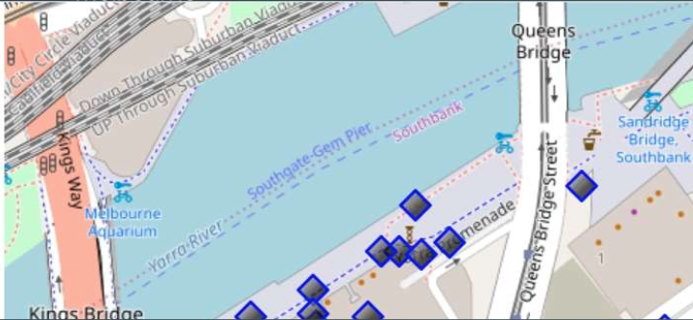
Current Neighborhood in Southbank Melbourne

Slide 8

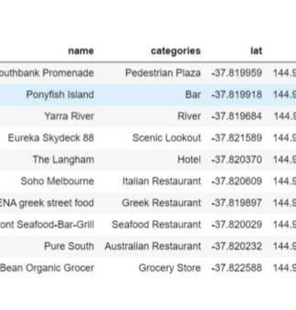
VENUES AROUND NEIGHBORHOOD IN SOUTHBANK MELBOURNE

Slide 9
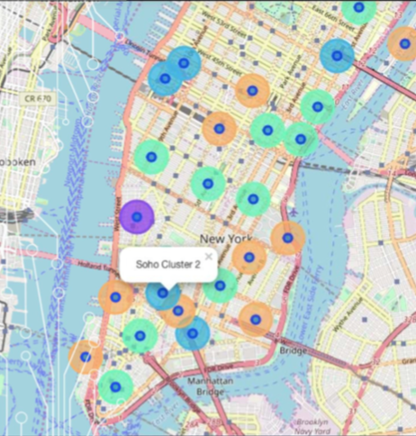
MANHATTAN MAP- NEIGHBORHOOD'S AND CLUSTEROF VENUES

Slide 10
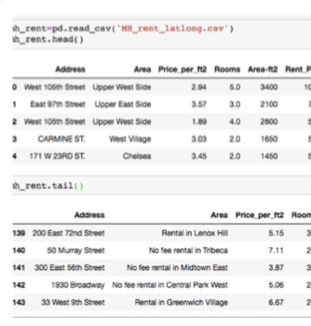
GEO DATA MANHATTAN
APS FOR RENT

Slide 11
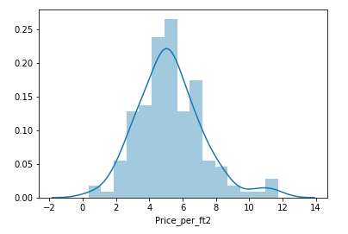
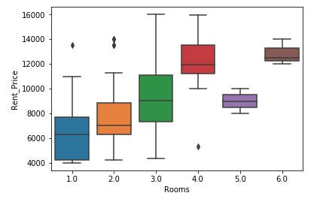
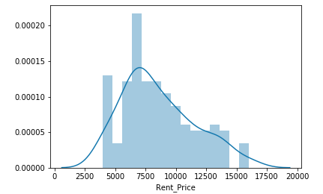
RENTAL PRICE STATISTICS MH APARTMENTS RENTAL BUDGET MEANS IS AROUND $7000USD

Slide 12
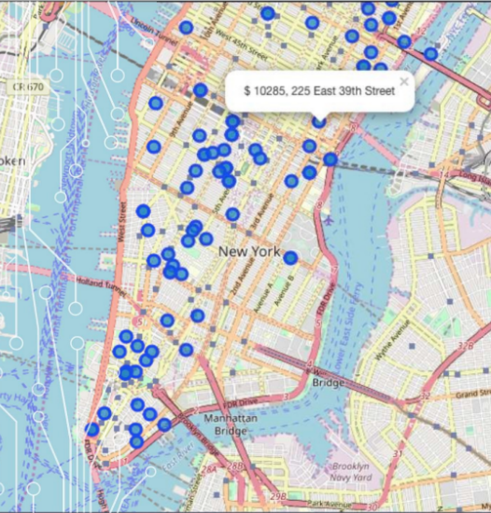
APARTMENTS FOR RENT IN MH

Slide 13
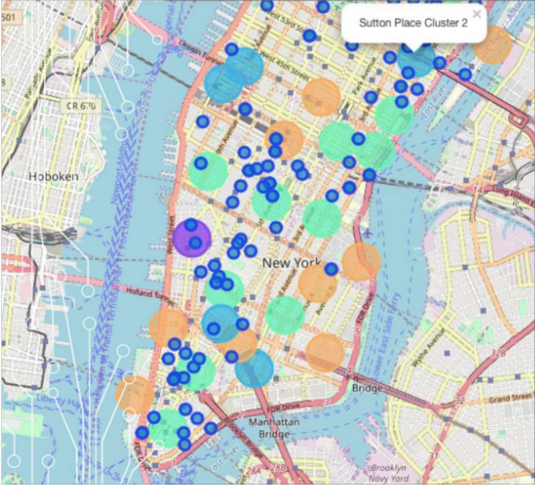
MH APARTMENTS FOR RENT WITH VENUE CLUSTERS

Slide 14
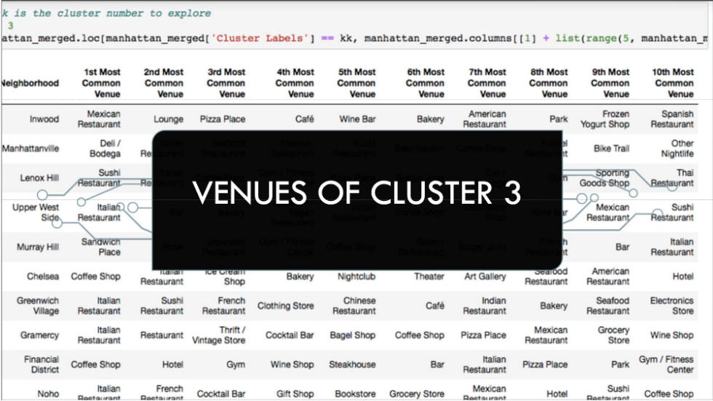

Slide 15
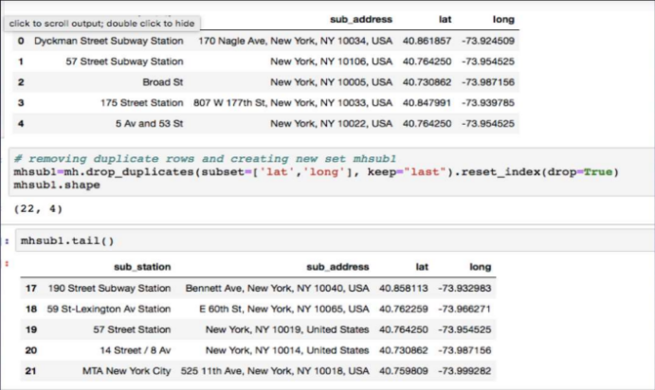
MH SUBWAY STATION DATA

Slide 16
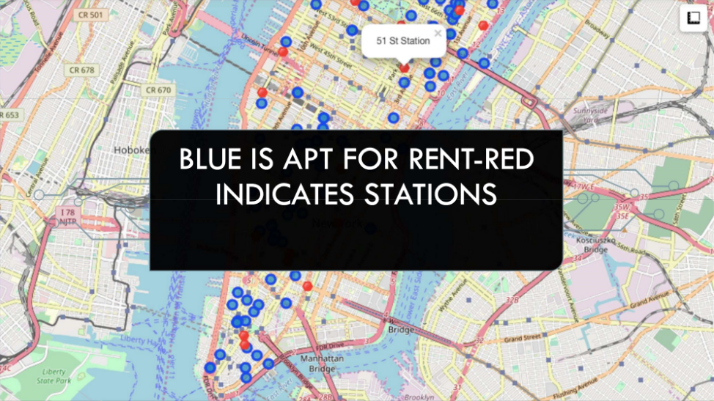

Slide 17
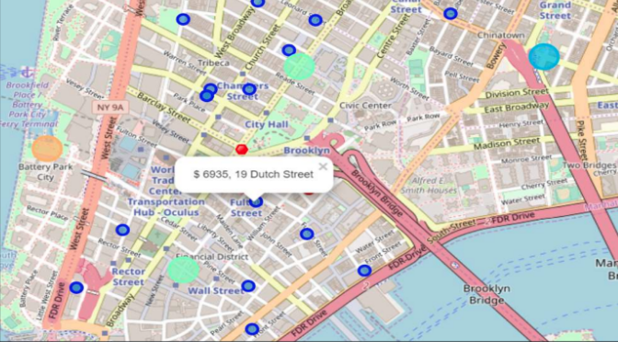
SELECTED APARTMENT The ONE consolidated map shows all information for decision: Apartments address, price, neighbour-hood, cluster of venues and subway station nearby. Blue dots=apts, Red dots=subway station, Bubles = Cluster of venues

Slide 18
APARTMENT SELECTION
Using the "one map" above, I was able to explore all possibilities since the popups provide the information needed for a good decision.
Apartment 1 rent cost is US7500 slightly above the US7000 budget. Apt 1 is located 400 meters from subway station at 59th street and work place (Park Ave and 53rd) is another 600 meters way. I can walk to work place and use subway for other places around. Venues for this apt are as of Cluster 2 and it is located in a fine district in the East side of Manhattan.
Apartment 2 rent cost is US6935, just under the US7000 budget. Apt 2 is located 60 meters from subway station at Fulton Street, but I will have to ride the subway daily to work, possibly 40-60 in ride. Venues for this apt are as of Cluster 3.
Based on current Southbank venues, I feel that Cluster 3 type of venues is a closer resemblance to my current place. That means that APARTMENT 2 is a better choice and cheaper which means I can use it for other expenses. However, there is the issue of transport.

Slide 19
5. DISCUSSION
I believe that convenience and location both matter a lot. Having to spend $7000 USD per month considering that I currently pay 2000 USD a month in Southbank and enjoying life means I should stay in Melbourne. I believe my income should be enough to justify rent of 30-35%. However the US opportunity is closer to 50% of the total, meaning that I am better off staying in Melbourne and looking for another opportunity.
In terms of the Coursera course: In general, I am very impressed with the overall organization, content and lab works presented during the Coursera IBM Certification Course. It helped me learn variety of data science tools with my zero previous knowledge of coding.
I feel this Capstone project presented me a great opportunity to practice and apply the Data Science tools and methodologies learned. I have created a good project that I can present as an example to show my potential.
I feel I have acquired a good starting point to become a professional Data Scientist and I will continue exploring to creating examples of practical cases.

Slide 20
6. CONCLUSION
I have decided to move to the US and stay in Melbourne considering the prices. I will explore Los Angeles for future career opportunities and run the same cost benefit analysis to make an informed data driven decision.
Final feedback on the overall data science course
I am very happy to be able to complete the 9 course specialization within couple of months.
The mapping with Folium is a very powerful technique to consolidates information and make the analysis and decision thoroughly and with confidence. I would recommend for use in similar situations.
Thank you for reviewing my work and thanks to the IBM/Coursera community for this outstanding course.

